Slide 1


CAPSTONE PROJECT
ELECTRIC VEHICLE ADOPTION AND ANALYSIS IN INDIA USING POWER BI
Presented By
Student Name: SUMANTH S
College Name: PRESIDENCY UNIVERSITY
Department: Electronics AND COMMUNICATION ENGINEERING
Email ID: sumanth.20231ece3059@presidencyuniversity.in

Slide 2
OUTLINE :-
Problem Statement
Proposed Solution
System Development Approach
Algorithm & Deployment
Result
Conclusion
Future Scope
References

Slide 3
Problem Statement :-
The adoption of Electric Vehicles (EVs) is rapidly increasing in India as the country moves towards sustainable transportation and reduced carbon emissions. However, EV adoption varies significantly across different states and regions due to factors such as infrastructure availability, government policies, and consumer awareness. Without proper data visualization and analysis tools, it becomes difficult for policymakers and industry stakeholders to understand EV growth trends and identify regions requiring infrastructure development. Therefore, a data-driven analytics dashboard is required to analyze EV adoption patterns and support strategic planning for EV infrastructure expansion.

Slide 4
Proposed Solution :-
The proposed system focuses on analyzing electric vehicle adoption trends in India using a data visualization dashboard developed in Power BI. The solution involves the following steps:
Data Collection :-
The electric vehicle sales dataset was collected from the Kaggle data platform. The dataset contains EV sales information in India from 2015 to 2025, including attributes such as year, vehicle category, vehicle segment, sales quantity, and EV market penetration percentage.
Data Preprocessing :-
The dataset was examined and cleaned to remove inconsistencies and ensure the data was properly structured. Column data types were corrected and the dataset was organized for analysis.
Data Analysis :-
The prepared dataset was analyzed using Microsoft Power BI. Various visualizations were created to study EV sales trends, compare vehicle categories, analyze vehicle segments, and observe EV market penetration over time.
Deployment :-
An interactive Power BI dashboard was developed that allows users to explore EV adoption trends through charts, filters, and analytical visuals.
Evaluation :-
The dashboard was evaluated based on its ability to clearly present EV adoption insights, sales growth trends, and market penetration patterns.

Slide 5
System Approach :-
This project follows a data analytics approach to study electric vehicle adoption trends in India using a Power BI visualization dashboard.
System Requirements
A computer system with Windows operating system.
Microsoft Power BI Desktop installed.
Internet access to download dataset from KAGGLE.
Basic knowledge of data visualization and analytics.
Tools / Software Used
Microsoft Power BI – used for creating interactive dashboards and visualizations.
Microsoft Excel / CSV dataset – used as the primary data source for EV sales analysis.
Microsoft Excel / Power BI Data Transformation tools – used for cleaning and organizing the dataset.
The dataset is processed in Power BI and transformed into visual representations that help analyze EV sales trends, vehicle categories, and market penetration patterns.

Slide 6
Algorithm & Deployment :-
This project follows a structured data analysis workflow to study electric vehicle adoption trends in India.
Algorithm / Workflow
Step 1: Data Input :-
The electric vehicle sales dataset (2015–2025) was imported into Microsoft Power BI in CSV format.
Step 2: Data Preparation :-
The dataset was reviewed and cleaned by correcting data types, removing inconsistencies, and organizing the columns for proper analysis.
Step 3: Data Modeling :-
Relevant attributes such as Year, Vehicle Category, Segment, Sales Quantity, and EV Penetration were used to build relationships and support meaningful analysis.
Step 4: Visualization :-
Various visualizations were created in Power BI, including line charts, bar charts, pie charts, and KPI cards to analyze EV sales trends and market penetration.
Step 5: Dashboard Deployment :-
An interactive Power BI dashboard was developed that allows users to explore EV adoption trends through filters and dynamic visualizations.

Slide 7
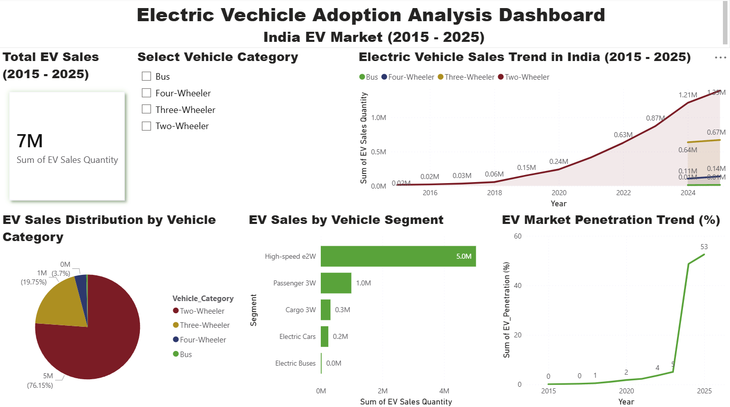
Result :-
Fig 1 : Dashboard in Power BI

Slide 8
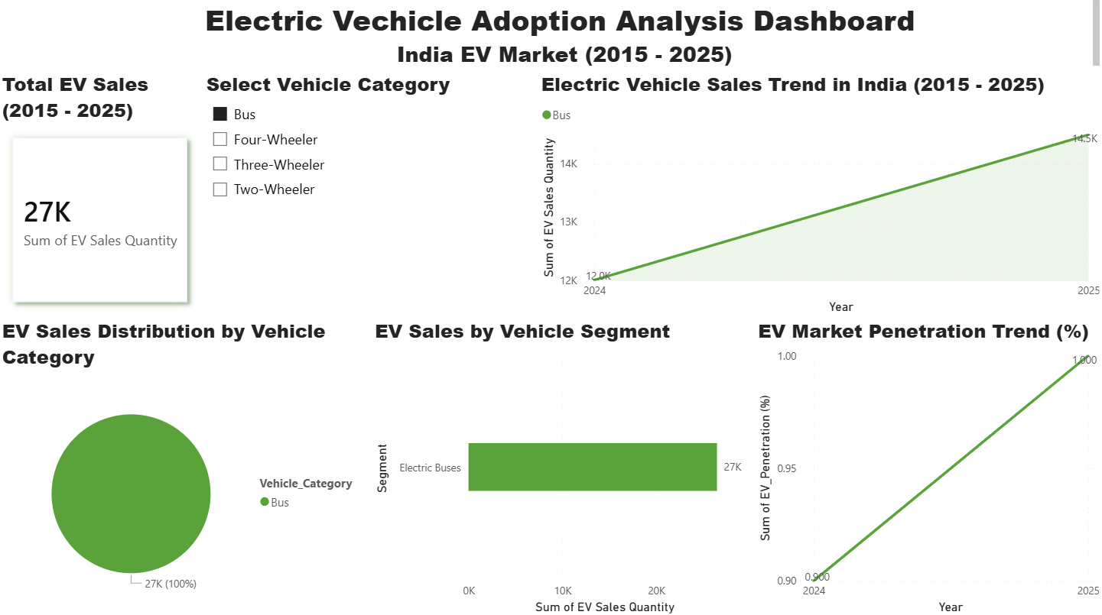
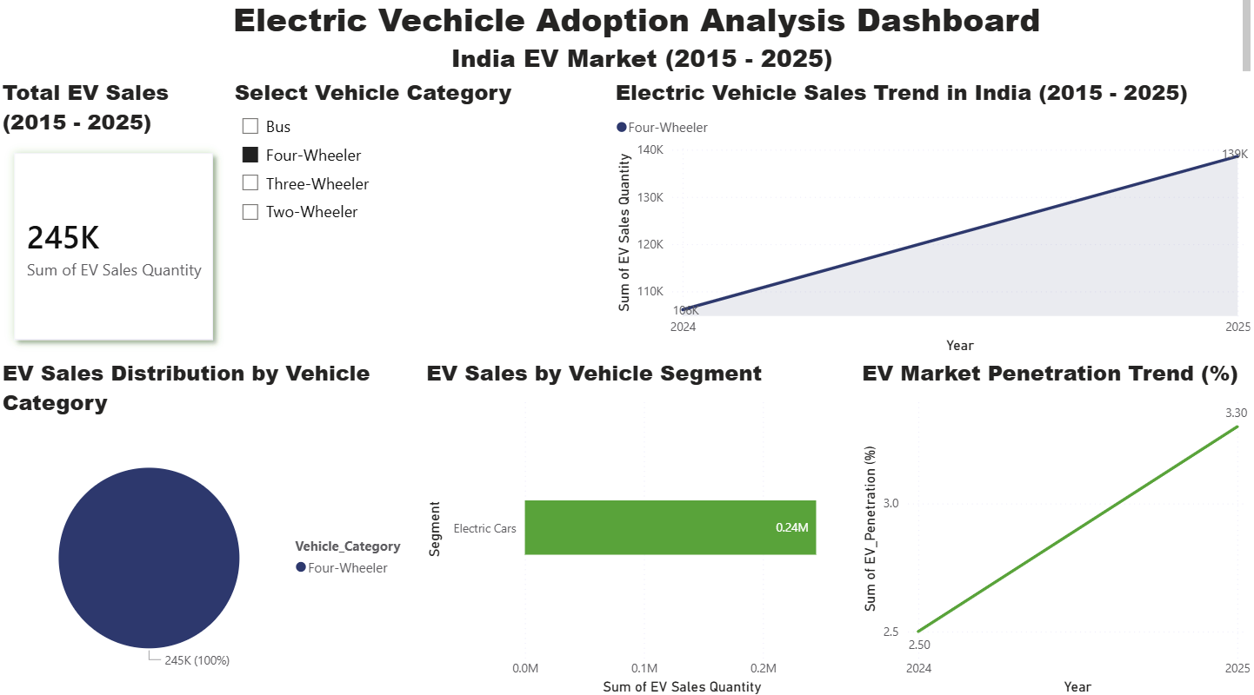
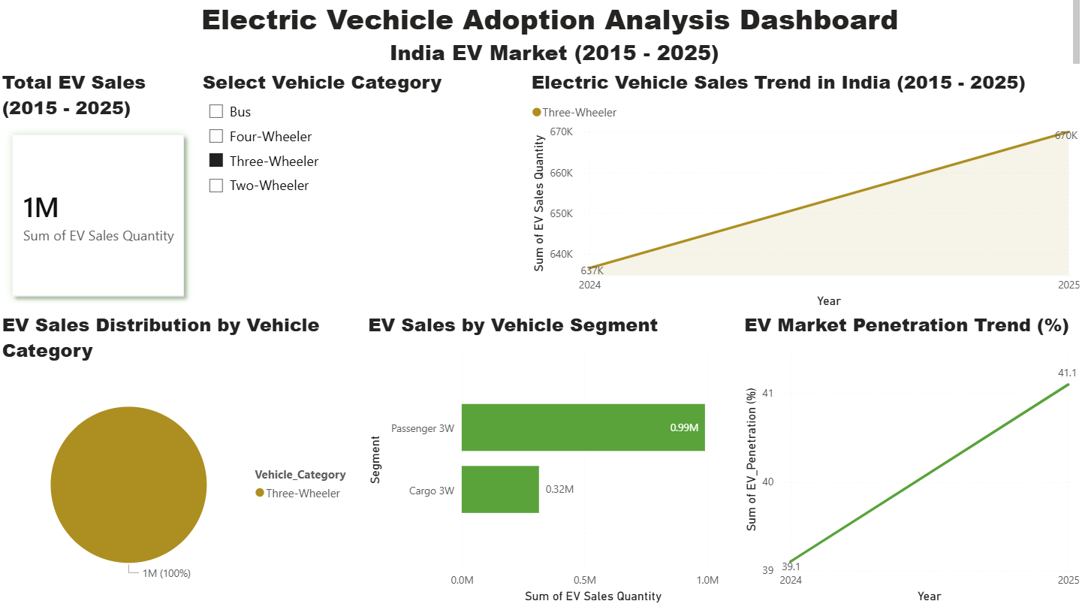
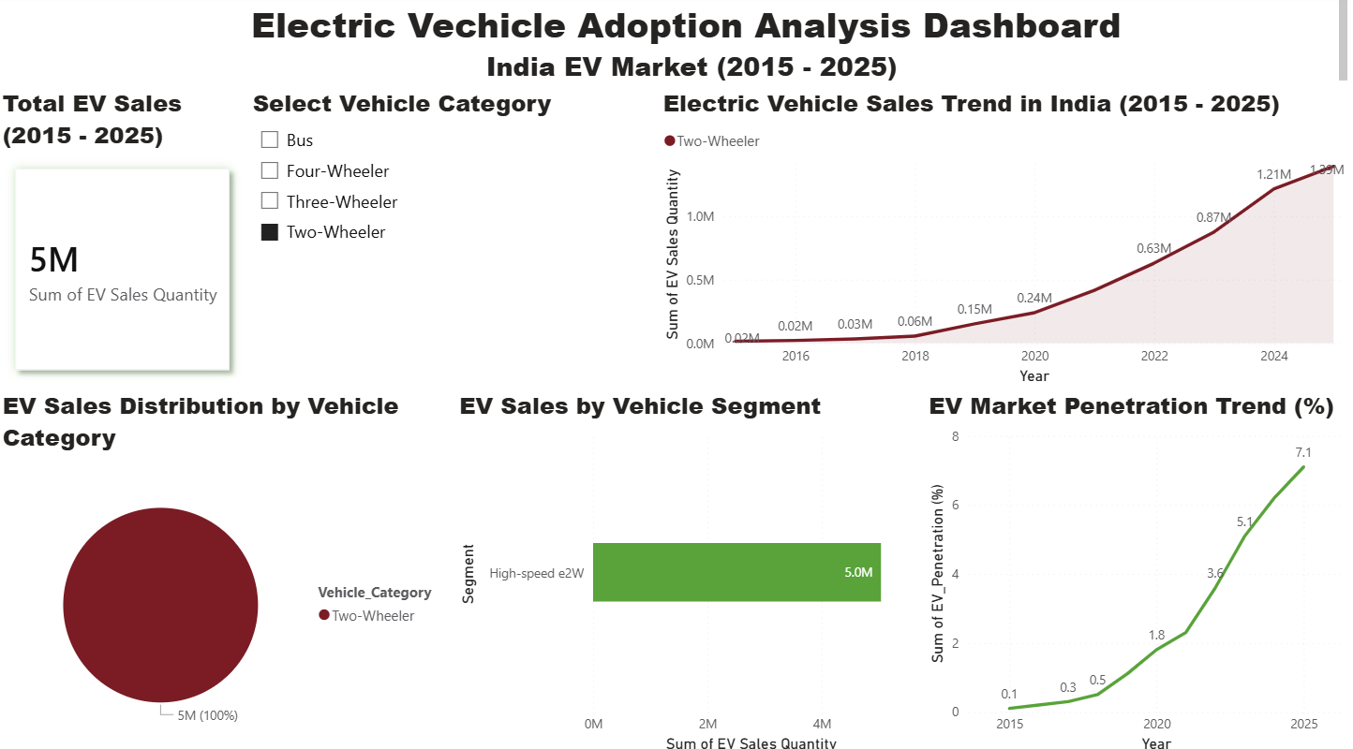
Result :-
Fig 2. Bus Analysis
Fig 3. Four-Wheeler Analysis
Fig 4. Three-Wheeler Analysis
Fig 5. Two-Wheeler Analysis

Slide 9
Result :-
EV sales in India have increased significantly after 2020, showing rapid growth in electric mobility adoption.
Two-wheelers dominate the EV market with the highest sales share compared to other vehicle categories.
EV market penetration has steadily increased from 2015 to 2025, indicating rising awareness and government support for electric vehicles.

Slide 10
Conclusion:
This project analyzes electric vehicle adoption trends in India using a Power BI dashboard based on EV sales data from 2015 to 2025.
The dashboard helps visualize EV sales growth, vehicle category distribution, and market penetration trends through interactive charts and visualizations.
The analysis shows that electric vehicle adoption in India has increased significantly in recent years, with two-wheelers contributing the largest share of EV sales.
Overall, the project demonstrates how data visualization tools like Power BI can transform raw datasets into meaningful insights that help understand market trends and support data-driven decision making.

Slide 11
Future scope:
This project can be further improved by incorporating additional datasets and advanced analytical techniques.
Future improvements could include integrating real-time electric vehicle registration data to monitor the latest EV adoption trends across India.
The analysis can also be extended by including information about EV charging infrastructure, government incentives, and regional policy support.
In addition, predictive analytics and machine learning models can be applied to forecast future EV sales trends and support better planning for sustainable transportation.

Slide 12
References :-
Kaggle – Indian Electric Vehicle Sales (2015–2025) Dataset,
https://www.kaggle.com/datasets/vagdevititikshag/indian-electric-vehicle-sales-20152025
NITI Aayog – Electric Vehicles in India Report.
India Electric Mobility Index Report – NITI Aayog.
Bryla, P. (2022). Consumer Adoption of Electric Vehicles: A Systematic Literature Review.
Sonjaya, R. P. (2025). Visualizing the Growth of Electric Vehicles Using Power BI.
GitHub Repository: https://github.com/SUMANTH-S-27/EV-Adoption-PowerBI-Dashboard.git

Slide 13
Thank You

